Slide 1


https://reactresources.com/topics/portals
http://redux.js.org

Slide 2

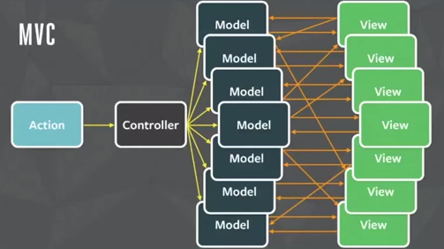
MVC & MVVM
The problem with this is when there are many views and models and one of the model’s state changed into something we didn’t expect, we are unable to efficiently trace which view or which model caused the problem.

Slide 3
Redux
All kinds of frameworks and architectures have state.
In Ember apps and Backbone apps, state is in Models.
In Angular apps, state is often in Factories and Services.
In most Flux , it is in Stores.
In Redux, the application state is all stored in one single tree structure called immutable state tree. (Single source of Truth with Unidirectional Data Flow.
The state is pure data. It doesn't have methods or functions. And it isn't tucked away inside objects. It's all in one place.

Slide 4

Reducer + Flux = Redux
Redux is a predictable state container for JavaScript apps.
Redux is a tiny library (2KB API) that acts as a container for application state, by combining ideas from Flux and Elm.
A simple, predictable state model. An emphasis on functional programming and immutable data.

Slide 5
Redux Principles
Single Source of Truth (Singleton)
State Is Read-Only (Immutable data)
State Is Changed with Pure Functions (Reducers) with immutability (always return new state)
(prevState, action) => newState
4. Unidirectional Data Flow
View -> Action -> Reducer(s) -> Store -> View
» console.log(store.getState())
« { user: {...}, todos: {...} }

Slide 6
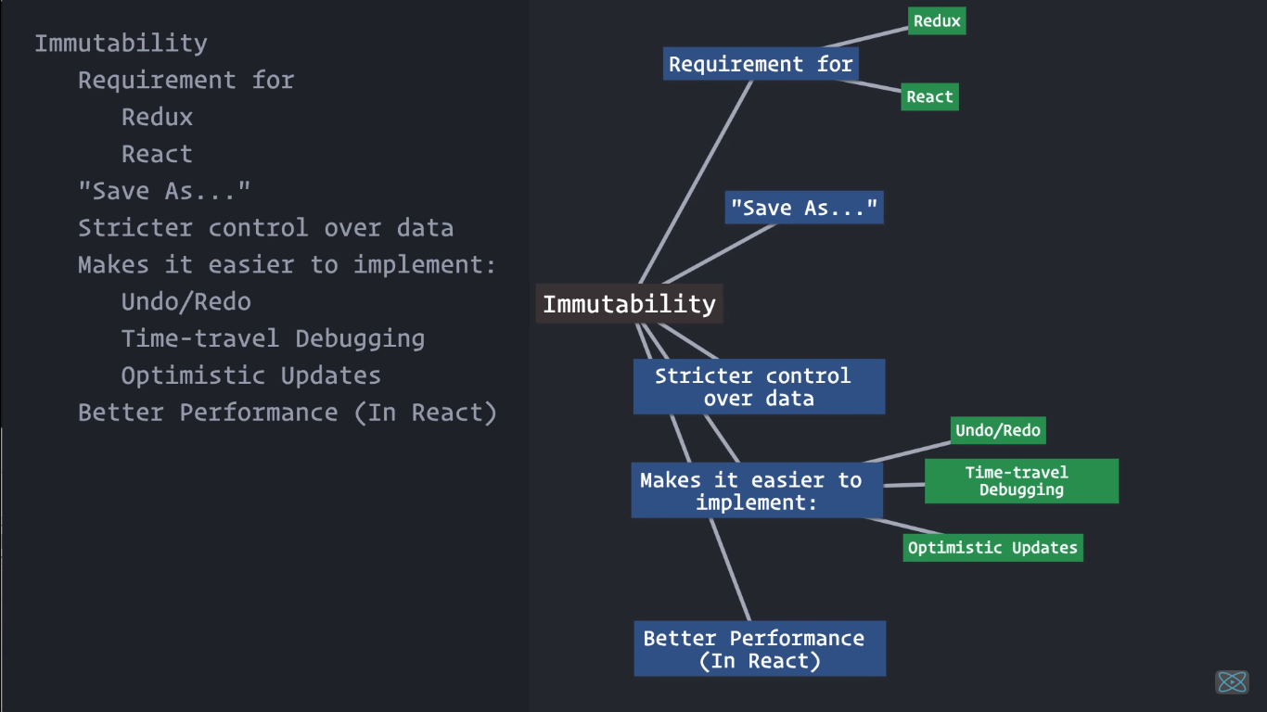
Immutability (Predictable state Management)

Slide 7
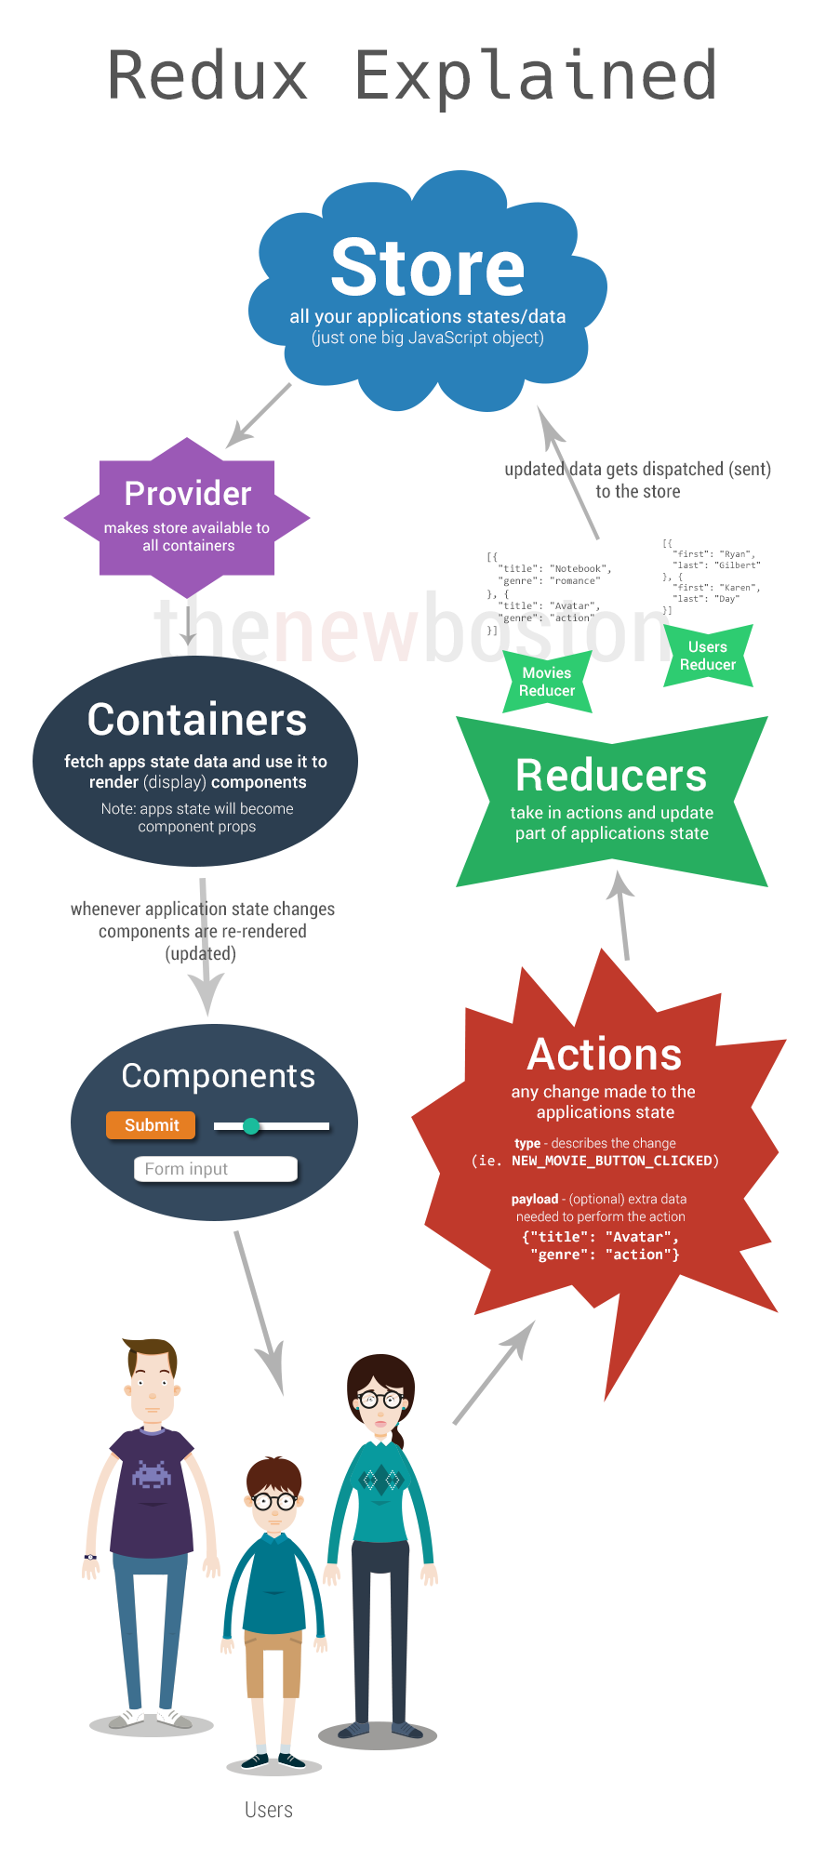

Slide 8
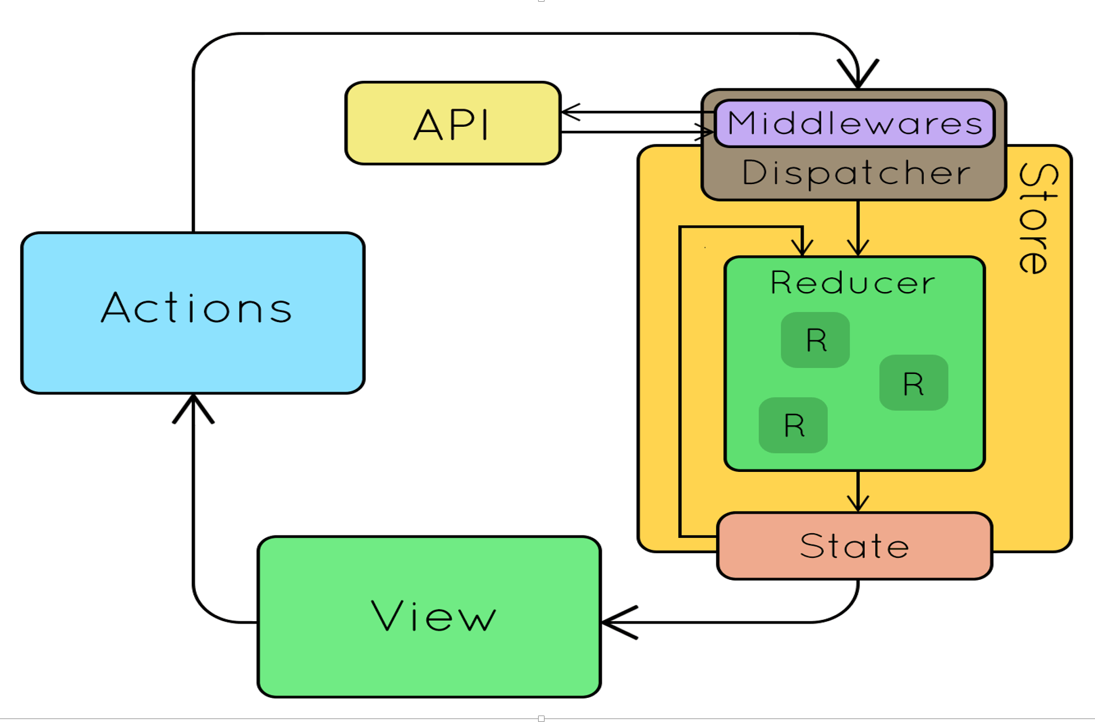
Redux

Slide 9
Redux

Slide 10
Redux
store: manages the states. All our application data and state resides here . (Like brain for app). In a Redux app, you can obtain its states via store.getState()
Provider makes all store available to containers (react-redux provider)
Containers : fetch app state data and use it to render components. (it is like a glue to connecct connect store to component. (connect). Whenever app state changes, component re-renders to keep state in sync with UI
App state becomes component props in React.

Slide 11
Store

Slide 12
State Tree

Slide 13
Redux
Component: UI widget of react component to display state from store.
action: A plain JavaScript object. Any changes made to application state (event handling). An action can also be considered as a command to change a state.
reducer: decides how to change a state after receiving an action, and thus can be considered the entrance of a state change. (we can have multiple reducers eg. MovieReducer, UserReducer… in youtube.com)
Take an action and update part of application state.

Slide 14
Reducer code with maintainability
function reducer(state, action) {
switch(action.type) {
case 'TODO_ADD' : {
return applyAddTodo(state, action);
}
case 'TODO_TOGGLE' : {
return applyToggleTodo(state, action);
}
default : return state;
}
}
function applyAddTodo(state, action) {
return state.concat(action.todo);
}
function applyToggleTodo(state, action) {
return state.map(todo =>
todo.id === action.todo.id
? Object.assign({}, todo, { completed: !todo.completed })
: todo
);

Slide 15
Redux
A reducer is comprised of functions, and it changes states by taking an action as an argument, in which it then returns a new state.
middleware:
The middleman between store.dispatch(action) and a reducer.
Its purpose is to intercept an action that has been dispatched, and modify or even cancel the action before it reaches the reducer.

Slide 16
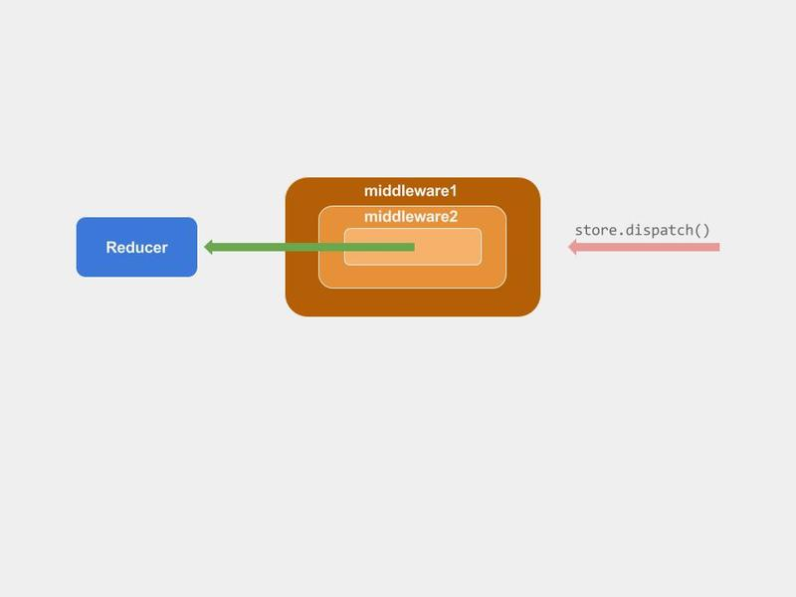
Redux

Slide 17
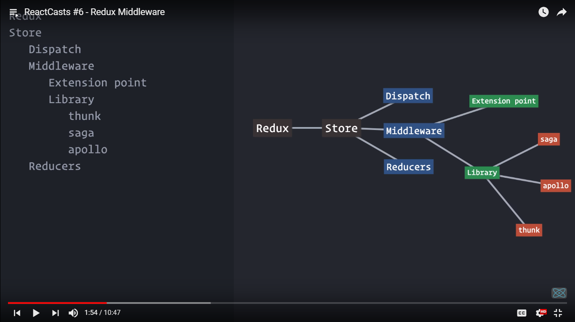
Redux

Slide 18
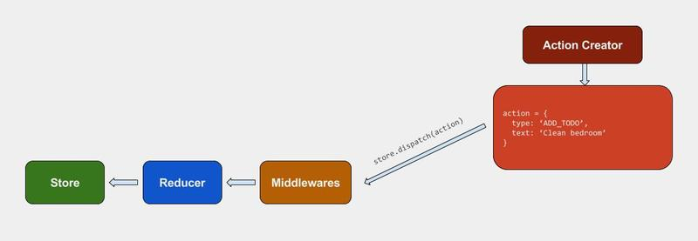
Redux

Slide 19
Redux
A Redux application's state tree is an immutable data structure.
Once state tree is created, it will never change as long as it exists.
It will keep holding the same state forever.
Go to the next state by producing another state tree that reflects the changes we wanted to make.
This means any two successive states of the application are stored in two separate and independent trees.
To go to the next state apply a function that takes the current state and returns a new state.

Slide 20
Redux
Benefit of single tree:
Hold on to the history of application state without doing much extra work
Just keep a collection of the previous state trees around.
Do things like undo/redo for "free" - just set the current application state to the previous or next tree in the history.
Serialize the history and save it for later, or send it to some storage so that to repay later, which can be hugely helpful when debugging.

Slide 21
Redux
To Install redux :
>npm install --save redux
Complementary Packages
React bindings and the developer tools.
>npm install --save react-redux
>npm install --save-dev redux-devtools
>npm install - - save redux-logger
>npm install - - save redux-thunk
>npm install - -save redux-axios

Slide 22
Redux
Redux attempts to make state mutations predictable by imposing certain restrictions on how and when updates can happen.
These restrictions are reflected in the three principles of Redux.
Single Source of Truth
The state of whole application is stored in an object tree within a single store. (In Flux , multi store)
So faster development lifecycle
Easy to debug

Slide 23
Redux
2. State is read-only
- The only way to change the state is to emit an action, an object describing what happened.
(actions are just plain objects, they can be logged, serialized, stored, and later replayed for debugging or testing purposes)
store.dispatch({
type: 'COMPLETE_TODO',
index: 1
})

Slide 24
Redux
3. Changes are made with pure functions
To specify how the state tree is transformed by actions- write pure reducers.
Reducers are just pure functions that take the previous state and an action, and return the next state.
We can have multiple reducers (Combined Reducer)

Slide 25
Flux vs Redux
Redux was inspired by several important qualities of Flux.
“stores” in Flux, “reducers” in Redux)
Instead of letting the application code directly mutate the data, both tell you to describe every mutation as a plain object called an “action”.
Redux does not have the concept of a Dispatcher
Redux assumes you never mutate your data.
Redux always return a new object, which is easy with the object spread operator proposal (Object.assign ,filter,concat,map) , or with a library like Immutable.
Time travel debugging, undo/redo

Slide 26
Redux - Actions
Actions are payloads of information that send data from application to store using store.dispatch();
They are the only source of information for the store.
Here's an example action which represents adding a new todo item:
Actions are plain JavaScript objects.
Actions must have a type property that indicates the type of action being performed.
Types should be defined as string constants.
import { ADD_TODO, REMOVE_TODO } from '../actionTypes‘ (actions moved to separate modules)
{ type: TOGGLE_TODO, index: 5 }

Slide 27
Redux - Reducer
Actions describe the fact that something happened, but don't specify how the application's state changes in response. This is the job of a reducer.
At the core of a Redux store is a function that takes the current application state and an action and combines them to create a new application state.
This function is called reducer.
Simple Reducer
CombinedReducers
Splitting reducers and loading from modules

Slide 28
Redux - Store
actions represent the facts about “what happened” and reducers update the state according to those actions.
The Store is the object that brings them together.
The store has the following responsibilities:
Holds application state;
Allows access to state via getState();
Allows state to be updated via dispatch(action);
Registers listeners via subscribe(listener);
Handles unregistering of listeners via the function returned by subscribe(listener).
only have a single store in a Redux application.
To split data handling logic, use reducer composition instead of many stores.

Slide 29

redux-observable
solve our
state problems.
http://reactivex.io/rxjs/manual/overview.html#operators

Slide 30
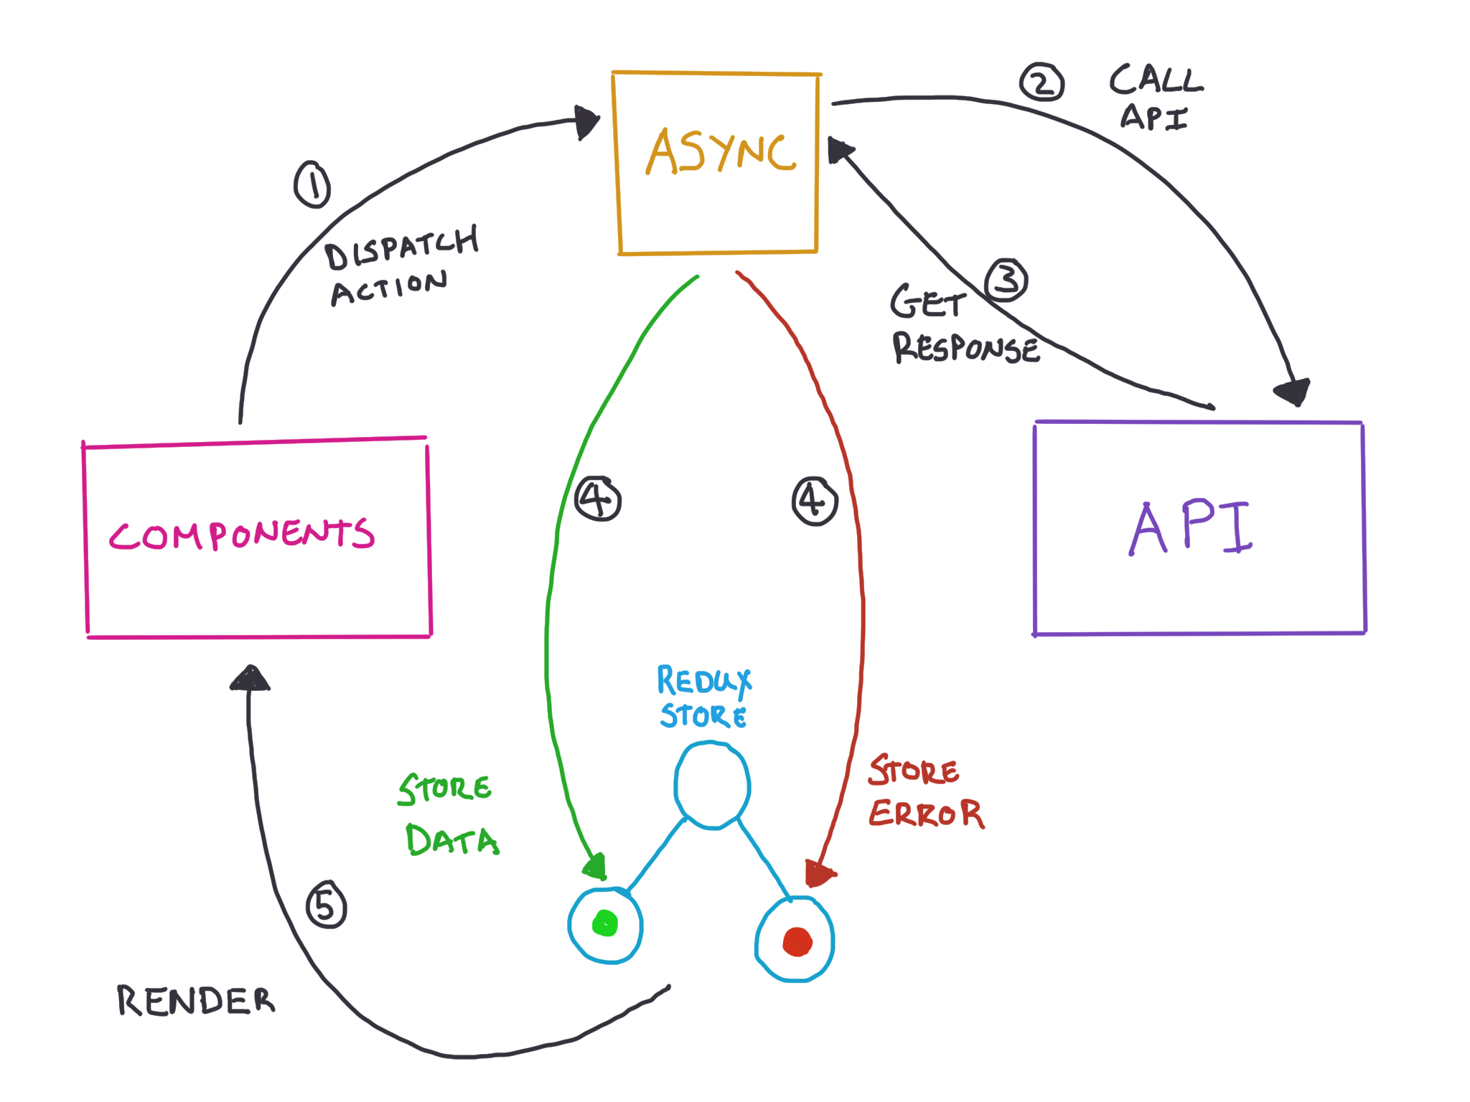
Async

Slide 31
RxJS – Redux-Observable
Redux async actions are achieved with
redux-thunk
redux-saga
redux-promise
redux-observable
custom middleware
redux-Observable is an middleware for Redux using RxJS.
Using Redux-Observable requires learning RxJS

Slide 32
Redux-thunk
The de facto middleware for executing async logic is redux-thunk, a middleware library created by Dan Abramov, who also created Redux.
With redux-thunk, instead of only publishing plain objects as actions, dispatch functions.
These functions are called thunks, and they will be called by the middleware, which will pass dispatch on the 1st parameter and getState on the 2nd parameter of the thunk.
We can execute async logic at later and use the dispatcher to dispatch downstream actions when you need to.

Slide 33
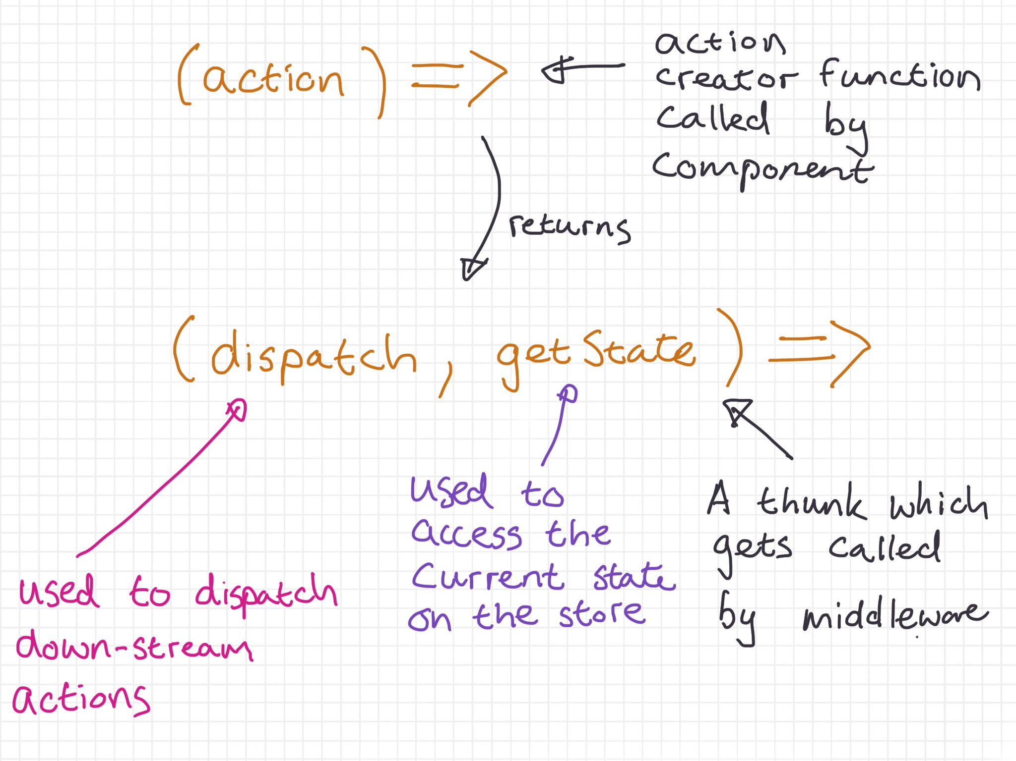
Redux-thunk

Slide 34

RxJS
Reactive programming is a declarative programming paradigm that deals with the flow of data in “streams” and with its propagation and changes.
RxJS, a library for reactive programming in JavaScript, has a concept of observables, which are streams of data that an observer can subscribe to,
and this observer is delivered data over time.
An observer of an observable is an object with three functions: next, error, and complete.

Slide 35
Redux-observable middleware
Redux-Observable is a Redux middleware that allows to filter and map actions using RxJS operators.
All actions dispatched by application should be available in an Observable stream and that down-stream actions caused by async logic should be available on an Observable stream.

Slide 36
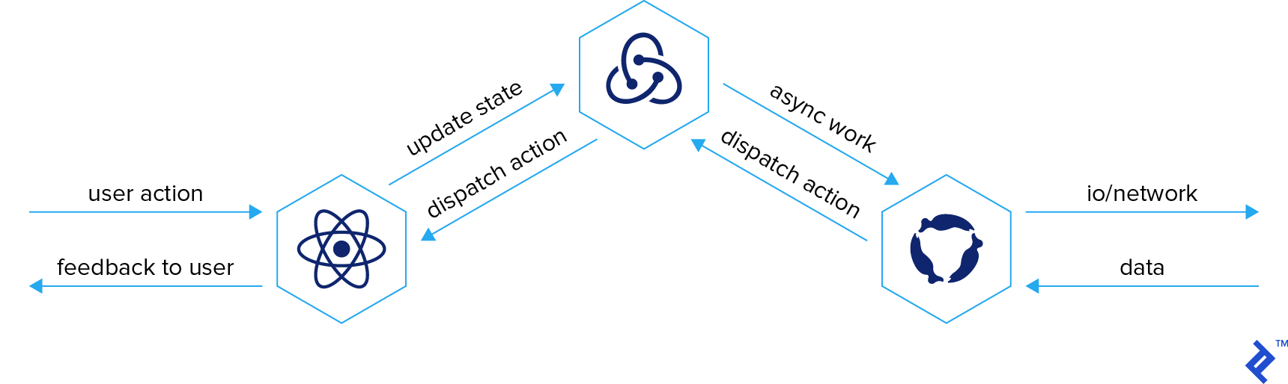
Redux-observable
Redux-observable middleware uses observable streams to perform asynchronous work and then dispatch another action in Redux with the result of that asynchronous work.

Slide 37
Redux-observable middleware
Redux-observable provide a function with an Observable input and an Observable output called epic.
"epic" is a function that takes a stream of actions and returns a modified stream of actions.
Epic (“saga” in redux-saga) is a description of what additional actions redux-observable should dispatch.
The Observable input represents all actions dispatched in the application and the Observable output represents all down-stream actions triggered by async logic.i.e. call actions in, actions out.

Slide 38
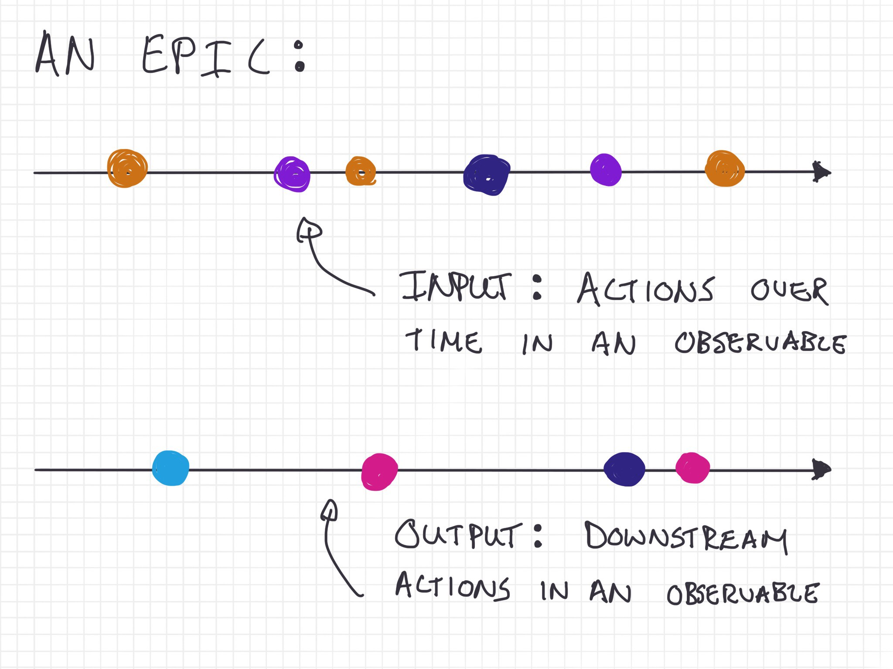
Redux-observable middleware

Slide 39
Redux-Observable
What is Redux-Observable
Redux-Observable abstracts out connecting to the Redux store and handles subscriptions for us so without worrying about listening for actions or dispatching .
It calls Redux’s dispatch function when it subscribes to all our epics (observable pipelines) at the same time.
allYourObservablesTogether .subscribe(store.dispatch)
npm install redux@4.x redux-observable@1.x rxjs@6.x

Slide 40
Redux-observable
const epic = action$ => action$
.pipe(
filter(action =>action.type === 'FOO'),
mapTo({ type: 'BAR' })
)
//or
import { ofType } from 'redux-observable'
const epic = action$ =>
action$.pipe( ofType('FOO'),
mapTo({ type: BAZ' }) )

Slide 41
Redux-observable
An 'epic' takes a single parameter, `action$`, which is an RxJS observable that represents the stream of all actions going through Redux
const countEpic = action$ => action$.pipe( filter(action => action.type === 'CLICK_INCREMENT'),
map(action => {
return { type: 'INCREMENT', amount: 1 }; }) );
const observableMiddleware = createEpicMiddleware();
const store = redux.createStore(reducer, redux.applyMiddleware(observableMiddleware));
observableMiddleware.run(countEpic);

Slide 42
Redux-Observable
For this example, communicating with a 3rd party service and telling it to start logging only after we have stored the user’s information; for instance, after a successful sign-in.

Slide 43
Redux-Observable
const startLoggingServiceEpic = ( action$, ) => ( action$ .pipe( ofType(UPDATE_USER_INFO), map(({ email, phone, userName, }) => ({ emailAddress: email, phoneNumber: phone, userName, })), tap(updateLoggingService), ignoreElements(), ) )
filter(({ type }) => ( type === 'USER::UPDATE_USER_INFO'))

Slide 44
Redux-Observable
ofType is like checking for action.type in a state reducer.
Any action that occurs will go through this ofType check and either proceed or stay.
Because a logging service requires our user’s data formatted in a certain way, we’ll map it to a new object, then pass that over to the logging service using tap.
tap is used to do side-effects such as a console.log or hook into a 3rd party tool like updateLoggingService.
It’s exactly the same as a Promise’s .then() except it doesn’t mutate the state of the pipeline.

Slide 45
RxJS
observable.subscribe({
next: value => console.log(`Value is ${value}`),
error: err => console.log(err),
complete: () => console.log(`Completed`),
})

Slide 46
RxJS
import { Observable } from 'rxjs'
const observable$ = new Observable(function subscribe(subscriber) {
const intervalId = setInterval(() => {
subscriber.next('hi');
subscriber.complete()
clearInterval(intervalId);
}, 1000);
});
observable$.subscribe(
value => console.log(`Value is ${value}`),
err => console.log(err)
)

Slide 47
RxJS
import { ajax } from 'rxjs/ajax'
ajax('https://jsonplaceholder.typicode.com/todos/1')
.subscribe(console.log)
// {request, response: {userId, id, title, completed}, responseType, status}
ajax.getJSON('https://jsonplaceholder.typicode.com/todos/1')
.subscribe(console.log)
// {userId, id, title, completed}
ajax({ url, method, headers, body })
.subscribe(console.log)

Slide 48
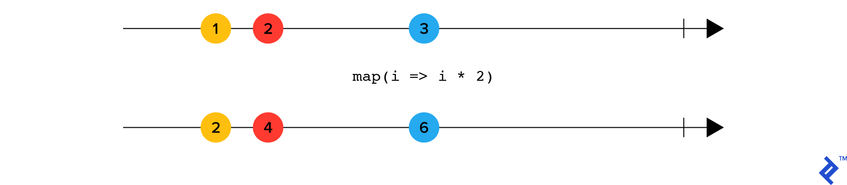
RxJS operators
import { of } from 'rxjs'
import { map } from 'rxjs/operators'
of(1, 2, 3, 4, 5).pipe(
map(i => i * 2) )
.subscribe(console.log) // 2, 4, 6, 8, 10
http://reactivex.io/rxjs/manual/overview.html#operators

Slide 49
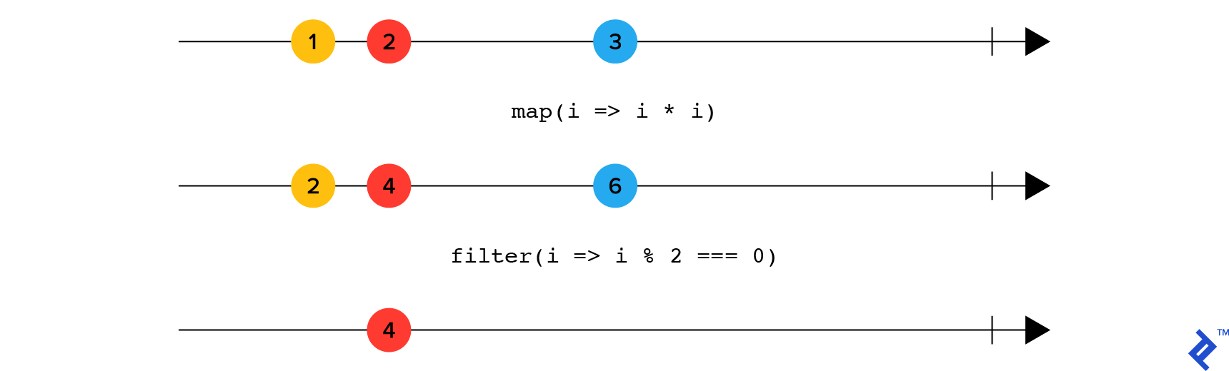
RxJS operators
filter takes a single argument and removes values from the stream which return false for the given function:
import { of } from 'rxjs'
import { map, filter } from 'rxjs/operators'
of(1, 2, 3, 4, 5).pipe(
map(i => i * i),
filter(i => i % 2 === 0) )
.subscribe(console.log) // 4, 16

Slide 50
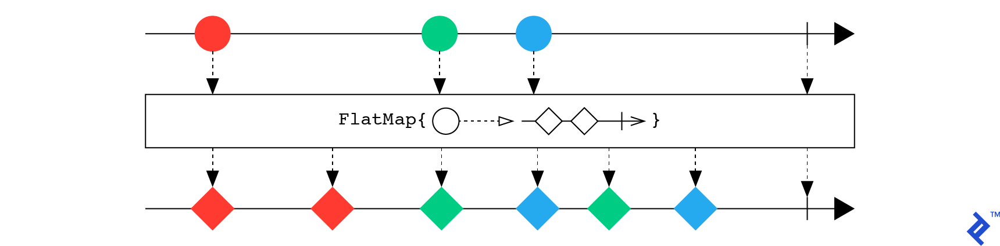
RxJS operators
flatMap operator takes a function that maps every item in the steam into another stream and flattens all the values of these streams:
import { of } from 'rxjs'
import { ajax } from 'rxjs/ajax'
import { flatMap } from 'rxjs/operators'
of(1, 2, 3).pipe(
flatMap(page => ajax.toJSON(
`https://example.com/blog?size=2&page=${page}`)), )
.subscribe(console.log)
// [ { blog 1 }, { blog 2 }, { blog 3 }, { blog 4 }, { blog 5 }, { blog 6 } ]

Slide 51
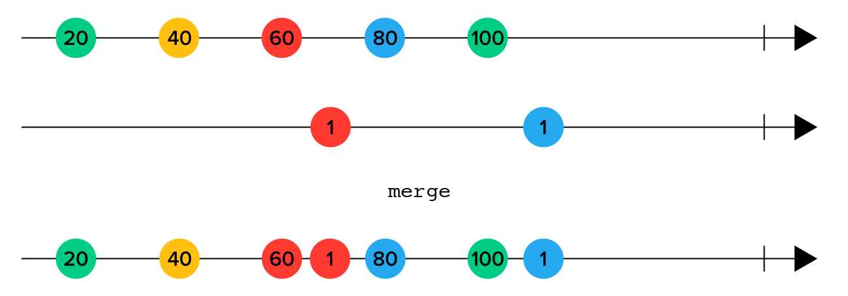
RxJS operators
merge : merges items from two streams in the order in which they arrive:
import { interval, merge } from 'rxjs'
import { pipe, take, mapTo } from 'rxjs/operators'
merge( interval(150).pipe(
take(5),
mapTo('A')),
interval(250).pipe(
take(5),
mapTo('B')) )
.subscribe(console.log) // A B A A B A A B B B

